Slide 1
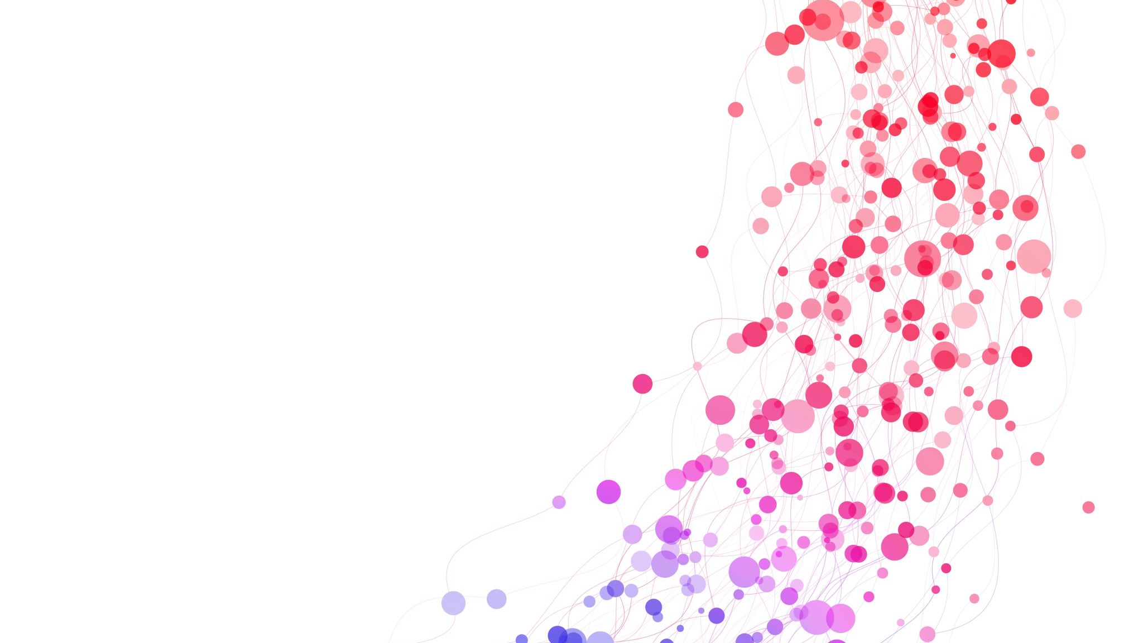

Automated Scoring for Reading Comprehension via In-context BERT Tuning (Paper Review)
By, Rahul Kumar

Slide 2
Automated Scoring (AS)
It refers to the problem of using algorithms to automatically score student responses to open-ended items.
Reduces the amount of human grading effort
Scale well to an ever-increasing student population
Automated Essay Scoring (AES)
Automatic Short Answer Grading (ASAG)
Humanities
Social Sciences
Math

Slide 3

Existing approaches for AS:
These approaches have excellent interpretability but require human expertise in feature development.
Length Summarization
Feature Engineering
Syntax
Predict
Score
+
Machine Learning based Classifiers
Cohesion
Item Relevance
Semantics

Slide 4
BERT
Leverage advancements
in Deep Learning
Recent approaches for AS
These approaches have demonstrated good scoring accuracy on publicly available benchmark datasets such as the automated student assessment prize (ASAP) for essay scoring.
GPT-2

Slide 5
Limitations
For each item, they mostly always train a separate AS model, not scalable.
Training a separate model for each item fails to leverage item linkage and shared semantics in contexts such as reading comprehension.
This method yields a separate model for each item which poses a significant model storage issue for LM-based models with millions of parameters.

Slide 6
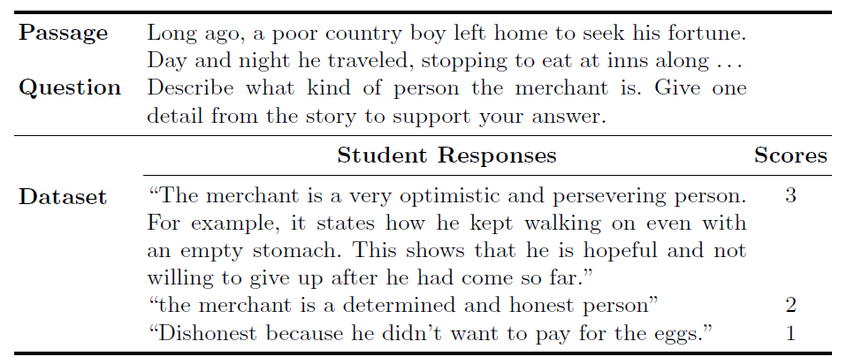
Methodology
Problem Formulation
Text snippets from an example grade 8 reading comprehension item

Slide 7
Author’s Approach: Meta-trained BERT with In-context Tuning
Utilizing In-context Learning.
The key idea is to learn a single shared BERT AS model across all items.
Add in-context examples to BERT input (response, score).
Leverages shared item linkage and semantics by providing context to the shared BERT AS model and associate it with each specific item.
Provides additional context about each item and enable BERT AS model contextualize to enable knowledge sharing across multiple items.

Slide 8
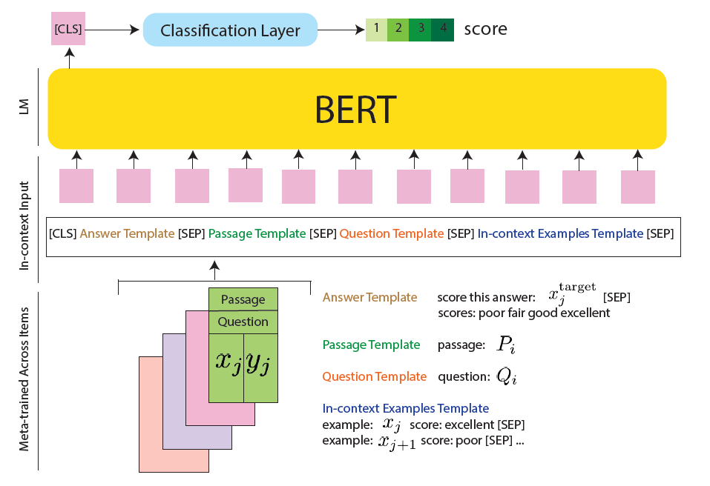

Slide 9
Metrics and Baselines
Human
Clustering
+ Classification
BERT
(response)
BERT
in-context
Majority
Stacked LSTM
BERT
(passage
+
Question
+
response)
BERT
multi-task
Feature Engineering
+
Random Forest
Meta-trained
BERT
in-context

Slide 10

Experimental Setup
The authors performed a five-fold cross validation on the training dataset and reported the average Quadratic Weighted Kappa (QWK) across all 20 items.
They used a pre-trained BERT model with 110M parameters. All implementation was done utilizing the ‘HuggingFace’ transformers library.
For Deep Learning model they used an Adam optimizer, a batch size of 32, a learning rate of $2∗{10}^{−5}$, and a maximum input length of 512 tokens.
Did not perform any hyperparameter tuning for BERT, fine-tuned all BERT-based models for 10 epochs (took 6 hours per training epoch on a single NVIDIA RTX 8000 GPU).

Slide 11
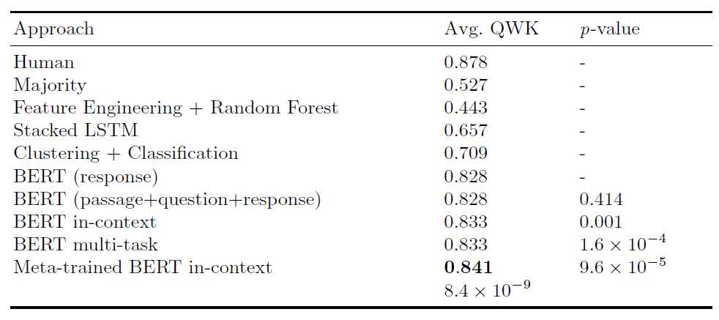
Experimental Results
Table-1: Experimental results averaged across reading comprehension items in the NAEP AS challenge dataset. Model performance in Quadratic Weighted Kappa (higher is better). Bold indicates best result except human performance.

Slide 12
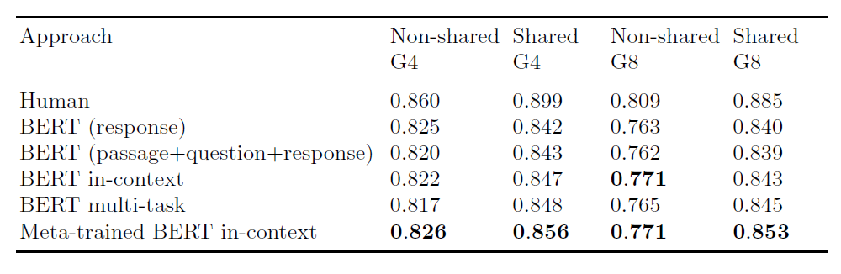
Table-2: Results averaged over shared vs. non-shared reading comprehension items from grade 4 (G4) and grade 8 (G8).

Slide 13
Results and Analysis
LM-based approaches consistently outperform non-LM-based approaches, by a significant margin.
Author's proposed method 'meta-trained BERT in-context' performed the best among all the models approaching human performance.
Learning a single shared model across items achieves statistically significant improvement over learning one model per item.
Feature engineering methods performed poorly and adding passage and question text as input in addition to response text doesn't improve the overall performance.
According to Table-2, author’s approach may struggle to generalize to previously unseen items.

Slide 14
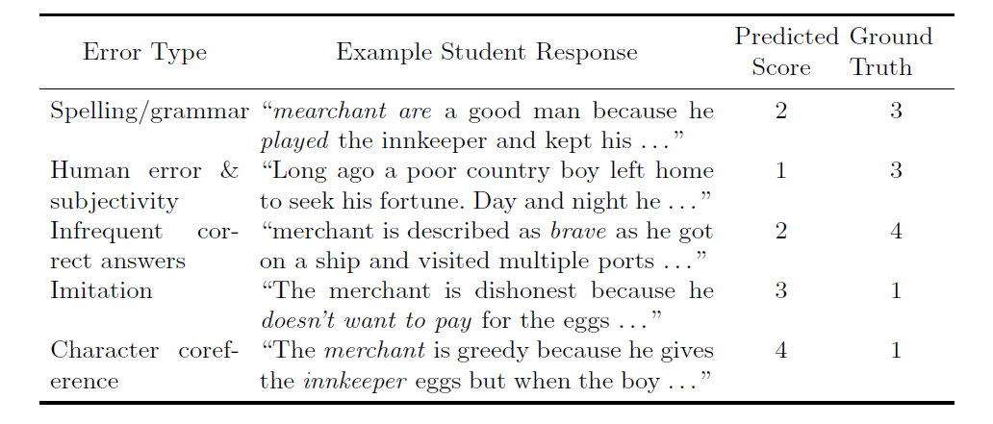
Qualitative Error Analysis

Slide 15
Conclusions and Future Work
Conducted model does not master the task of reading comprehension.
Additional spell-checking step improves performance and using BERT only as a text featurization tool without fine-tuning leads to a significant drop in scoring accuracy.
Future
Work
Should find ways to retrieve only relevant sentences using small number of tokens
Future
Work
Pre-training BERT on student-generated text before applying them to downstream tasks could improve overall performance

Slide 16
Conducted model is still a black-box.
Conducted models, without explicitly controlling for fairness, exhibit unavoidable but modest biases toward students in different demographic groups.
Future
Work
Should find ways other ways to improve model interpretability, such as using attention maps
Future
Work
Should incorporate fairness regularization into the training objective to promote fairness across students

Slide 17
THANK YOU

